Slide 1
Math 152
Lesson | Topic | Reading
36 | Polar Coordinates | 10.3
37 | Areas & Lengths in Polar Coords | 10.4
38 | 3D Systems | 12.1 / 12.2
Objectives:
Calculate areas enclosed by polar curves using polar coordinates
Calculate arc length of curves defined in polar coordinates

Slide 2
Area and Circumference
Whole circle:
Sector:
Area:
Circumference:

Slide 3
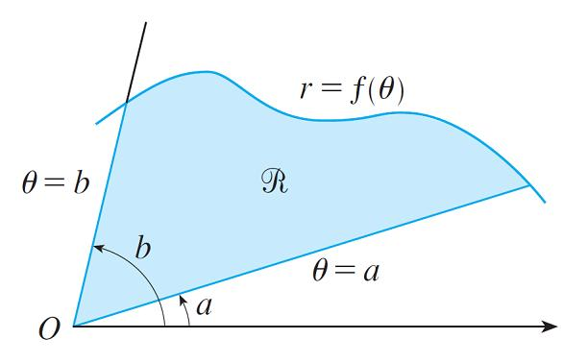
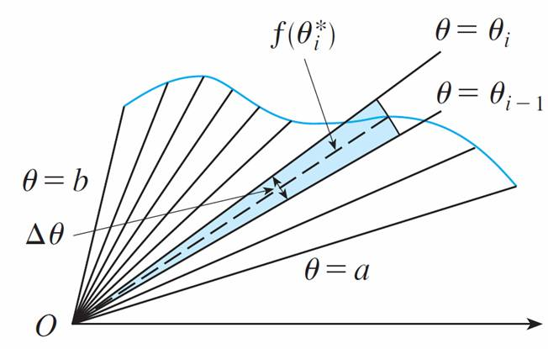
Area
Now let r be defined by a function … how do we calculate the area?

Slide 4
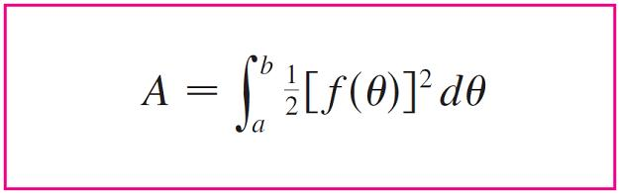
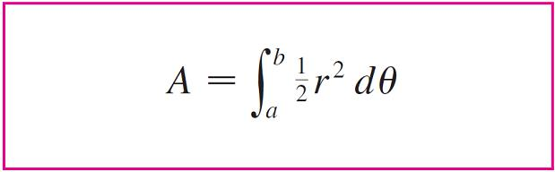
Area
A = r²θ

Slide 5
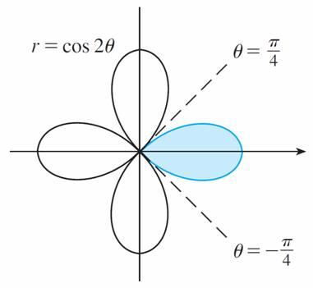
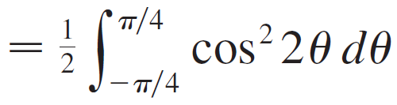
Example
Find the area enclosed by one loop of the four-leaved rose r = cos 2θ.
Solution:

Slide 6
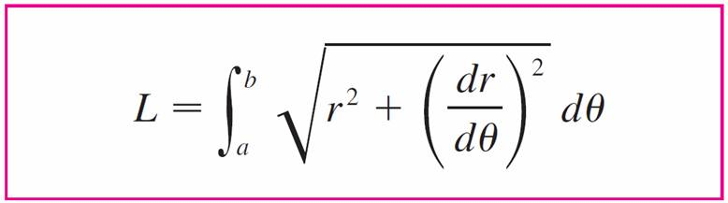
Arc Length

Slide 7
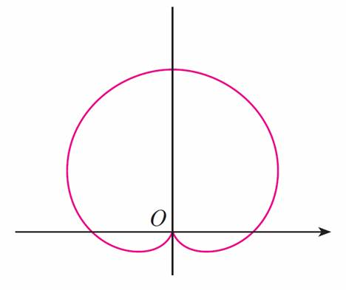
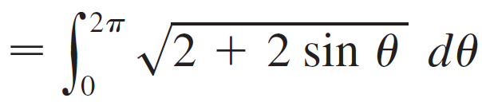
Example
Find the length of the cardioid r = 1 + sin θ.
Solution:
L = 8

Slide 8
Desk Work
Half Angle Formulas:

Slide 9
Solutions

